Slide 1


“CHILDREN, ESPECIALLY GIRLS AGED 2-12 HAVE ACCESS TO QUALITY EDUCATION WITH IMPROVED INFRASTRUCTURE AND SAFE LEARNING ENVIRONMENT”
Prepared By: ITA RYK.

Slide 2
Components of ITA
School Improvement Program in 70 Schools (10 Schools Physically Rehabilitated)
ECD Center / Sanjha Vehra
Learning 4 Access (Piloting Program)
Vocational Centers ( TEVTA)
2 svs Model village
Unilever ( Soft component partner)

Slide 3
“CHILDREN, ESPECIALLY GIRLS AGED 2-12 HAVE ACCESS TO QUALITY EDUCATION WITH IMPROVED INFRASTRUCTURE AND SAFE LEARNING ENVIRONMENT”
Outcome 1:
Children have access to improved infrastructure and safe learning environment
Output 1.2
schools 70 schools are supplied with learning materials, furniture and Para Teachers
For implementation of improved infrastructure and safe learning environment ITA has provided missing facilities & furniture in 10 targeted schools as per need of schools.

Slide 4
“CHILDREN, ESPECIALLY GIRLS AGED 2-12 HAVE ACCESS TO QUALITY EDUCATION WITH IMPROVED INFRASTRUCTURE AND SAFE LEARNING ENVIRONMENT”
Outcome 1:
Children have access to improved infrastructure and safe learning environment
Output 1.2
schools 70 schools are supplied with learning materials, furniture and Para Teachers
Appointment of 40 Para-teachers
To ensure quality of education we provided temporary teachers to provide support in our partner school.

Slide 5
“CHILDREN, ESPECIALLY GIRLS AGED 2-12 HAVE ACCESS TO QUALITY EDUCATION WITH IMPROVED INFRASTRUCTURE AND SAFE LEARNING ENVIRONMENT”
Outcome 1:
Children have access to improved infrastructure and safe learning environment
Output 1.2
schools 70 schools are supplied with learning materials, furniture and Para Teachers
Reading Kits, Health Kits, Sports Kits, TLM’s ( Teacher learning material )
ECE kits, Health kits, sports kits, visit registers and national curriculum were distributed in all 70 partner schools
Science kits were provided in 10 schools

Slide 6
“CHILDREN, ESPECIALLY GIRLS AGED 2-12 HAVE ACCESS TO QUALITY EDUCATION WITH IMPROVED INFRASTRUCTURE AND SAFE LEARNING ENVIRONMENT”
Outcome 2:
Issues relating quality of education are addressed
Output 2.1 300 schools, teachers and school councils provided quality inputs for learning, ECE, DRR, hygiene, life skills and environmental education
    Training of Head teachers, School Teachers and Para Teachers were conducted by ITA
Before training TNA was conducted in 70 Schools
During reporting quarter ITA conducted 3 days training workshop to improve the learning levels of students and enhance the teaching skills of the teachers for the promotion of Quality Education.
Six days Subject Base Training on English, Math and Science
Two days Training on Health & Hygiene Training
Two days Training on Early Childhood Education
Two days Training on Disaster Risk Reduction
120 PSTs and Para teachers were trained in that workshop

Slide 7
“CHILDREN, ESPECIALLY GIRLS AGED 2-12 HAVE ACCESS TO QUALITY EDUCATION WITH IMPROVED INFRASTRUCTURE AND SAFE LEARNING ENVIRONMENT”
Outcome 2:
Issues relating quality of education are addressed
Output 2.2
School Enrichments Programs
Summer School 2012-13
As part of a non-academic, positive learning experience, summer school provide a safe environment where children can develop self-confidence, social skills, and good work habits while still allowing them to be “kids” having fun.
Summer School was conducted in 25 Schools

Slide 8
“CHILDREN, ESPECIALLY GIRLS AGED 2-12 HAVE ACCESS TO QUALITY EDUCATION WITH IMPROVED INFRASTRUCTURE AND SAFE LEARNING ENVIRONMENT”
Outcome 2:
Issues relating quality of education are addressed
Output 2.3
School Enrichments Programs
Life Skills Sessions
Life skill sessions were conducted in targeted schools in which Education promoters told to the children about different life skills.
Personal hygiene
Cleanliness
Speak the truth
Obeying elders
Punctuality etc.

Slide 9
“CHILDREN, ESPECIALLY GIRLS AGED 2-12 HAVE ACCESS TO QUALITY EDUCATION WITH IMPROVED INFRASTRUCTURE AND SAFE LEARNING ENVIRONMENT”
Outcome 3: Catch Up Program for out of school children
Outcome
Output 3.1 catch up program for 1000 vulnerable children 8-12 in afternoons
Catch up program was for those children who were never enrolled or dropped out for some reasons. It was an afternoon program to enhance reading capability of children and to mainstream them in respective classes or level. It was conducted in Jam Pur on basis of ASER results.

Slide 10
“CHILDREN, ESPECIALLY GIRLS AGED 2-12 HAVE ACCESS TO QUALITY EDUCATION WITH IMPROVED INFRASTRUCTURE AND SAFE LEARNING ENVIRONMENT”
Component 2: Targeting 3000 children in affected Districts of Punjab & Sindh (minimum 20 schools) with essential basic school and educational materials (Back to School Kits) to enable quality learning
Output 4.1 3000 worst affected children provided full school kits including, bags, stationery, shoes and uniforms
    Children in affected areas supported with uniforms, bags, stationary
1000 School kits were distribution in 2 schools(Uniform, Sweaters, shoes, notebooks, Bag etc.)

Slide 11
“CHILDREN, ESPECIALLY GIRLS AGED 2-12 HAVE ACCESS TO QUALITY EDUCATION WITH IMPROVED INFRASTRUCTURE AND SAFE LEARNING ENVIRONMENT”
Component 3: Construction of 15 ECD Centers catering to 3000 children (Ages: 6 months to 6 years) with support for health, hygiene, life skills; ECD learning, recreation and nutrition training for mothers and care givers
Outcome 5: 15 ECD Center establish for Readiness skills provided for children3-4, enabling them to enroll & persist in local schools
    We have started 04 SVs Model Village 48/NP, Basti Mud Adil, Saweya Ahna, Waghwan and they are going well. To enroll children and meeting with mothers were conducted in respective villages.

Slide 12
“CHILDREN, ESPECIALLY GIRLS AGED 2-12 HAVE ACCESS TO QUALITY EDUCATION WITH IMPROVED INFRASTRUCTURE AND SAFE LEARNING ENVIRONMENT”
International Days Celebration
    Independence day
    Literacy Walk on “International Literacy Day” 8th September 2012
    Global Action week
    Malala Day

Slide 13
“CHILDREN, ESPECIALLY GIRLS AGED 2-12 HAVE ACCESS TO QUALITY EDUCATION WITH IMPROVED INFRASTRUCTURE AND SAFE LEARNING ENVIRONMENT”
Achievements
    Students enrollment is increased 13%
    10 schools physically rehabilitated
    Transfer of land on the name of school GGPS Makhan Bela 1
    After training teaching methods and techniques are changed
    The school are improved in health and hygiene environment.
    Close coordination with Department, DTEs and SHNSs.

Slide 14
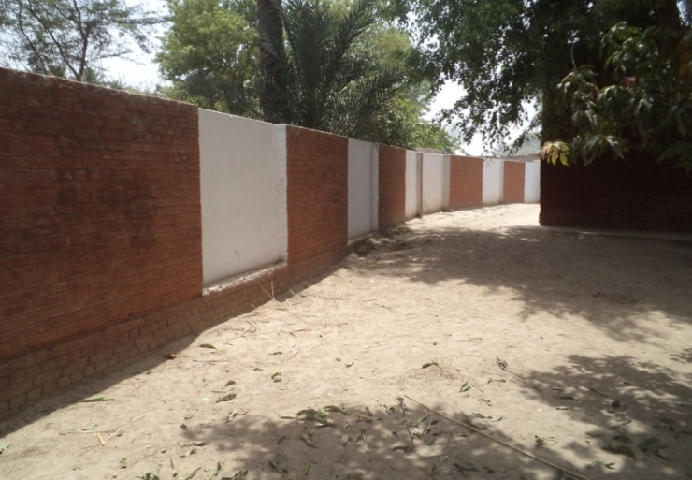
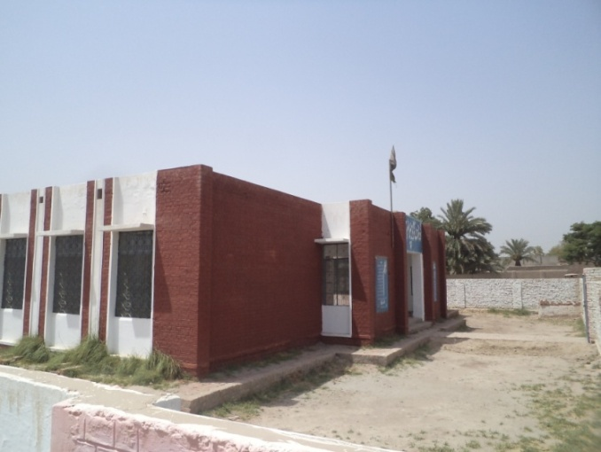
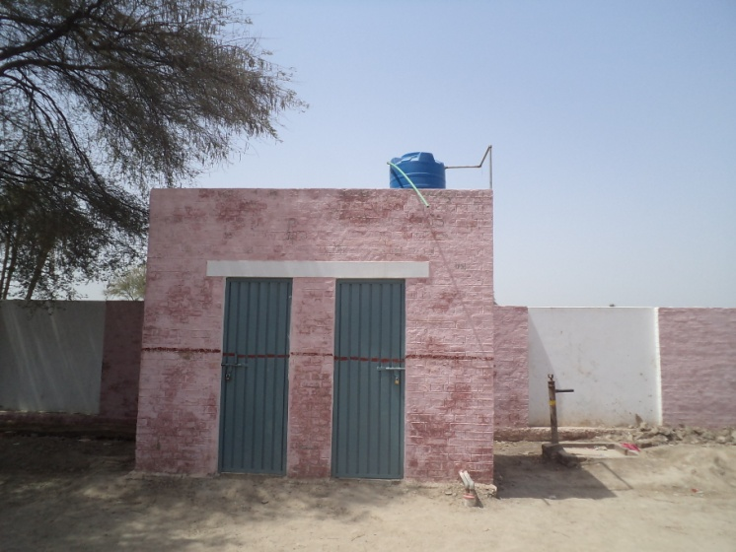
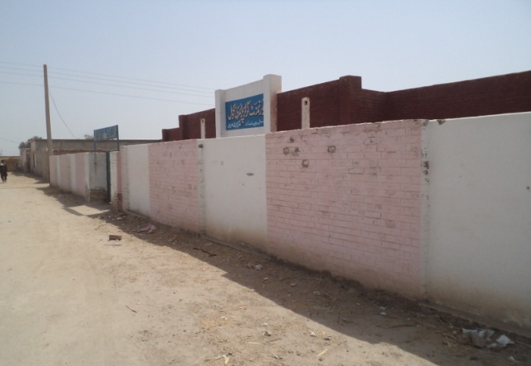
“CHILDREN, ESPECIALLY GIRLS AGED 2-12 HAVE ACCESS TO QUALITY EDUCATION WITH IMPROVED INFRASTRUCTURE AND SAFE LEARNING ENVIRONMENT”
Physical Rehabilitation
Bondary wall in GGPS Gud Pur | Renovated building of GGPS Abdullah Khan
Toilet block in GGPS Jam Majeed

Slide 15
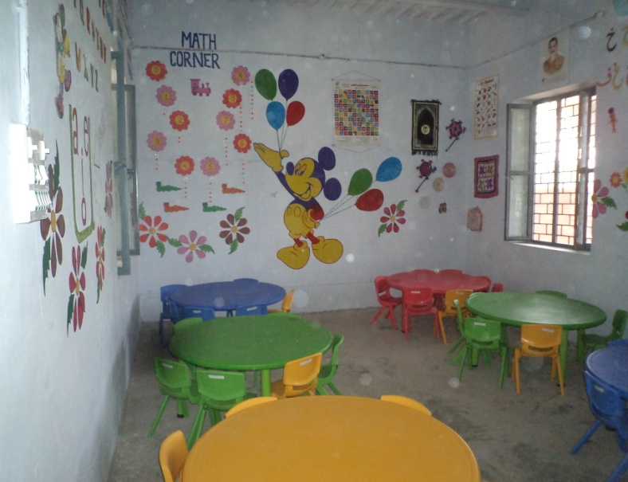
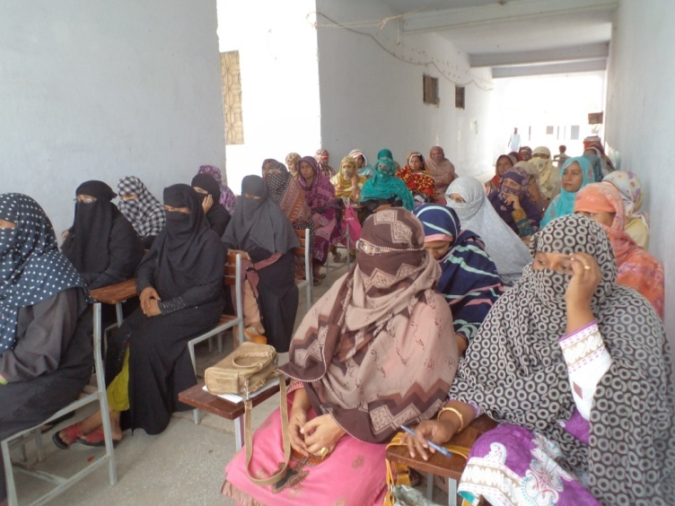
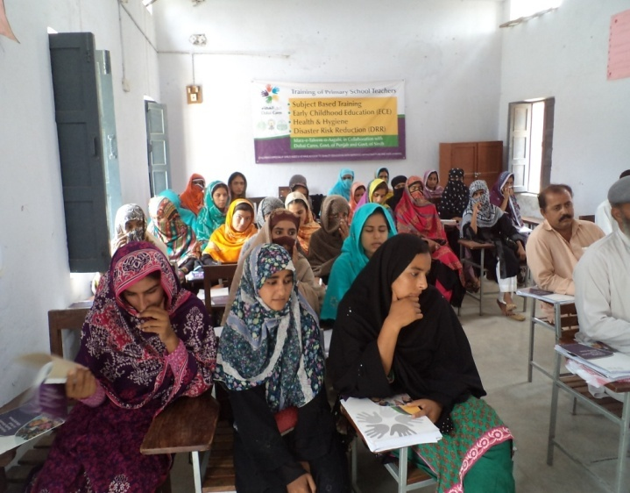
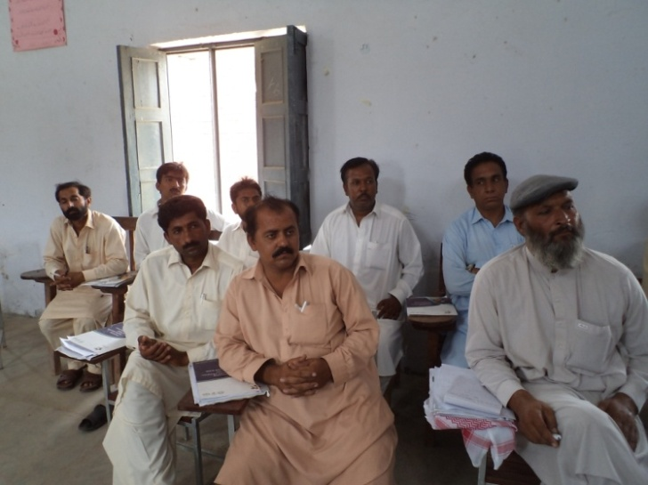
“CHILDREN, ESPECIALLY GIRLS AGED 2-12 HAVE ACCESS TO QUALITY EDUCATION WITH IMPROVED INFRASTRUCTURE AND SAFE LEARNING ENVIRONMENT”
2 Weeks Training

Slide 16
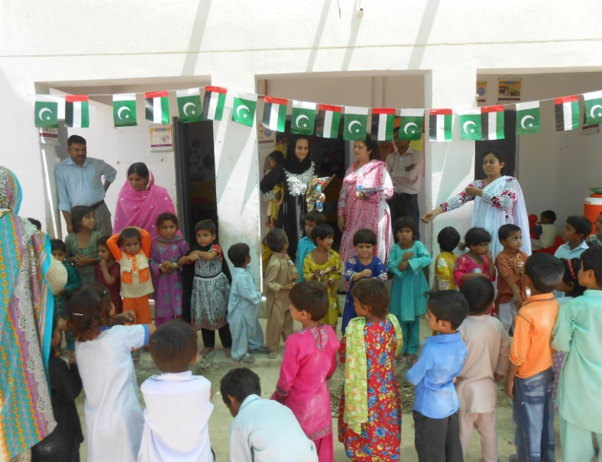
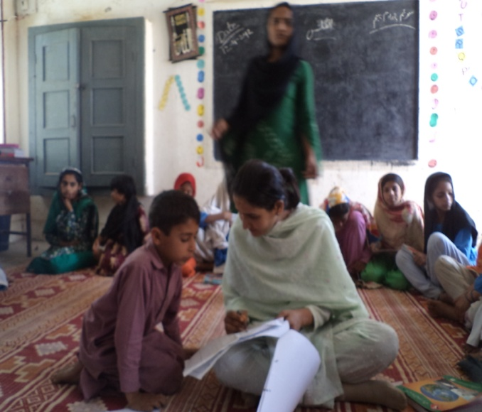
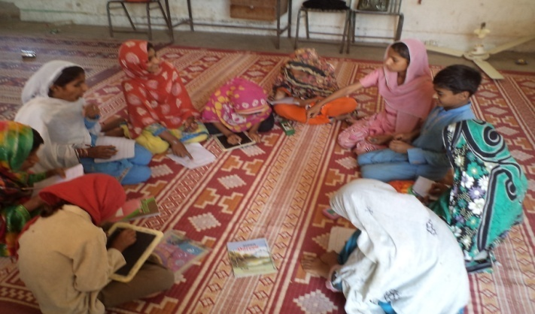
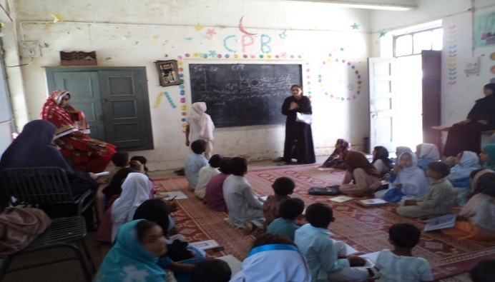
“CHILDREN, ESPECIALLY GIRLS AGED 2-12 HAVE ACCESS TO QUALITY EDUCATION WITH IMPROVED INFRASTRUCTURE AND SAFE LEARNING ENVIRONMENT”
Chalo, Parho, Barho

Slide 17
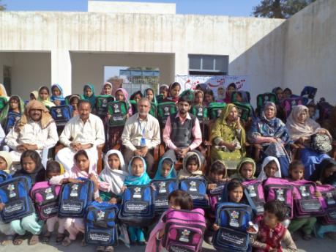
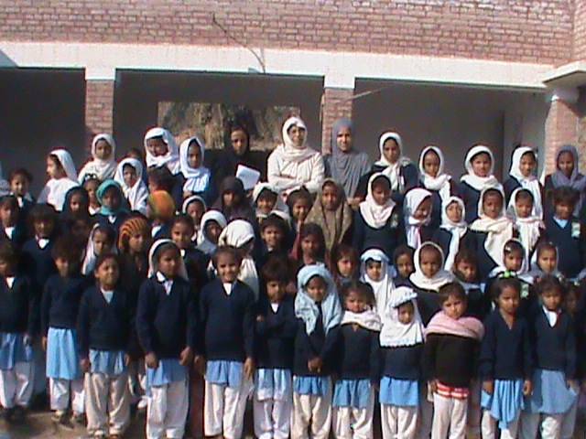
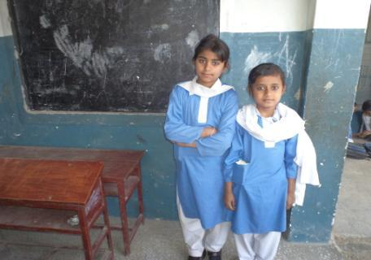
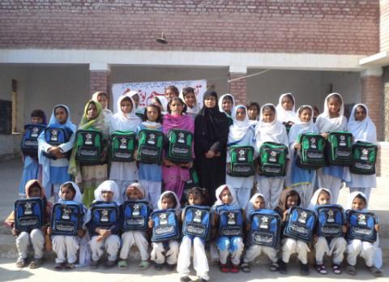

Slide 18
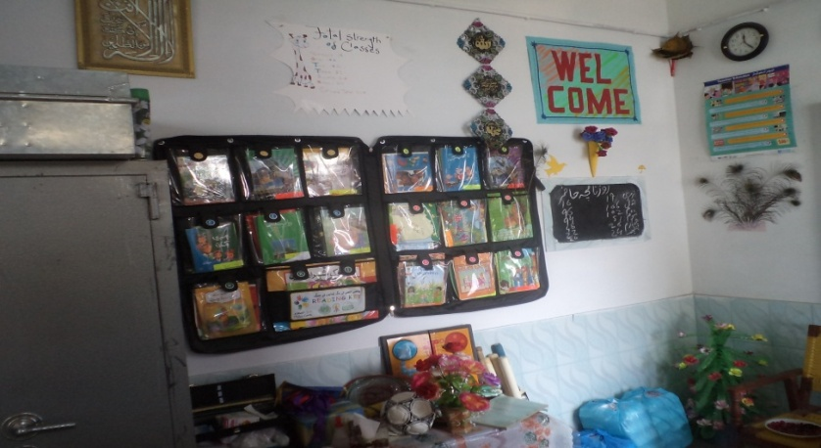
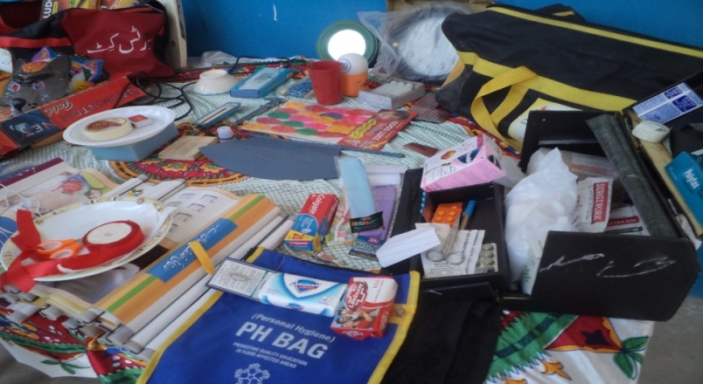
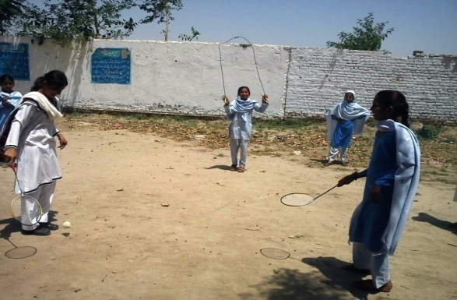
Pictorial View Of Kits
Reading Kit
Health Kit
Sports Kit

Slide 19
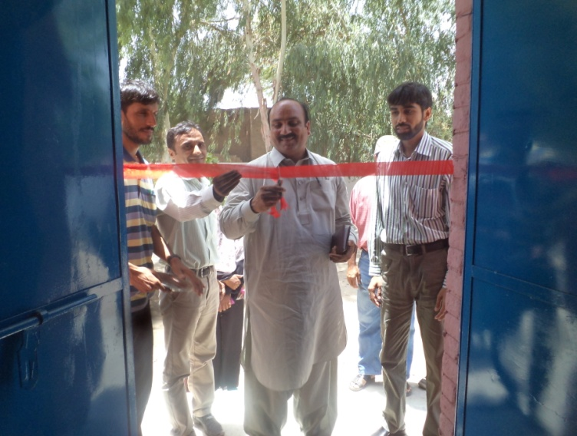
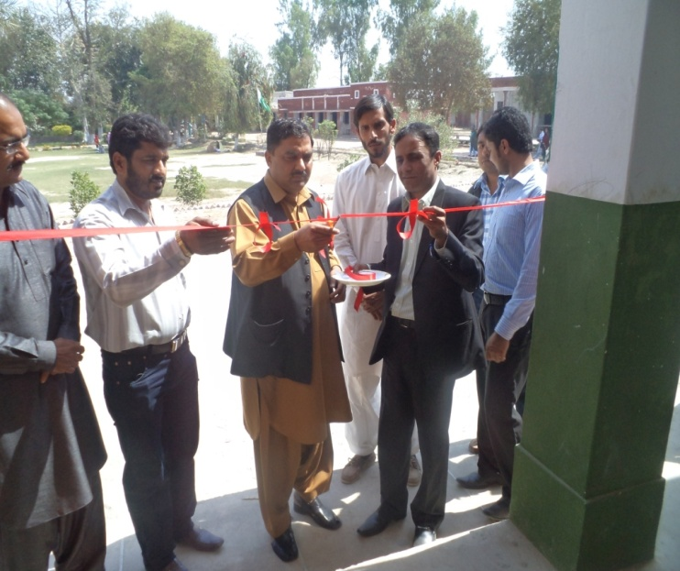
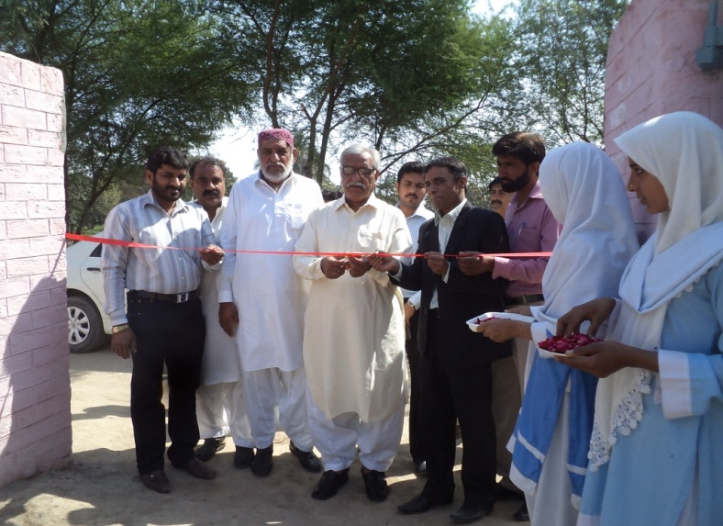
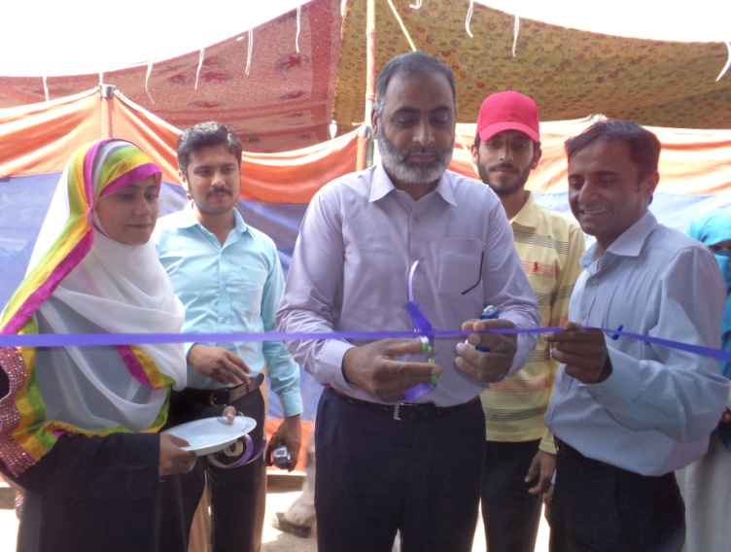
“CHILDREN, ESPECIALLY GIRLS AGED 2-12 HAVE ACCESS TO QUALITY EDUCATION WITH IMPROVED INFRASTRUCTURE AND SAFE LEARNING ENVIRONMENT”
School inaugurations

Slide 20
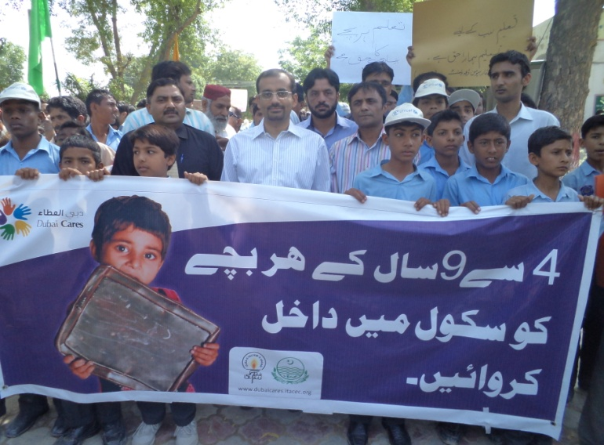
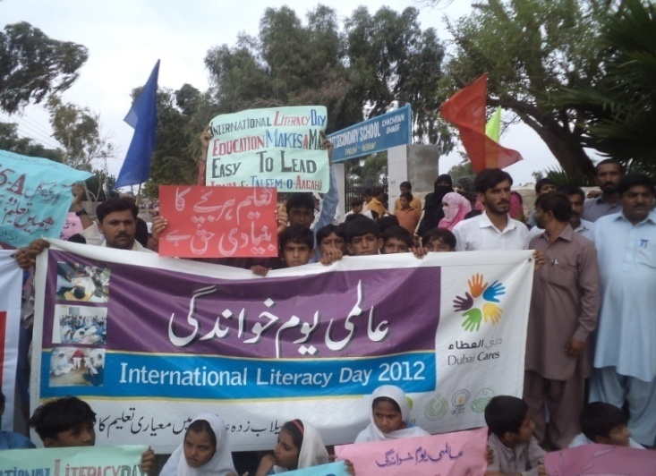
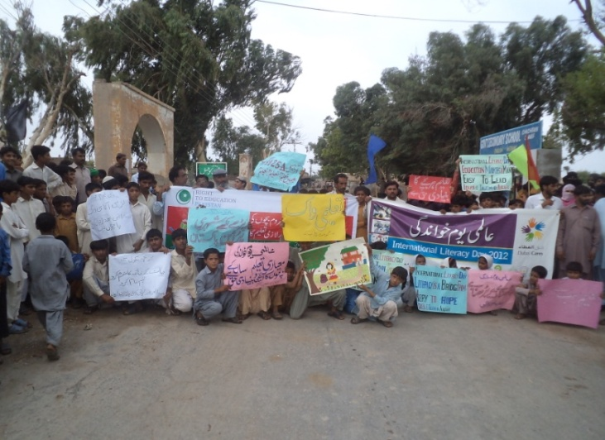
“CHILDREN, ESPECIALLY GIRLS AGED 2-12 HAVE ACCESS TO QUALITY EDUCATION WITH IMPROVED INFRASTRUCTURE AND SAFE LEARNING ENVIRONMENT”
Literacy Walk

Slide 21
“CHILDREN, ESPECIALLY GIRLS AGED 2-12 HAVE ACCESS TO QUALITY EDUCATION WITH IMPROVED INFRASTRUCTURE AND SAFE LEARNING ENVIRONMENT”
    Thank you

